Slide 1
Round Table Innovation and sustainibility
Mauro Napoletano

Slide 2
What is the relationship with mainstream economics?
The majority of models in the literature are CGE based Integrated Assessment Models (IAMs)
DICE (Nordhaus, 1992, 2008; Nordhaus and Sztorc, 2013), FUND (Tol, 2002), PAGE (Hope, 2006), WiTCH (Bosetti et al., 2006; Emmerling et al., 2016), Stern Review (Stern, 2007)
These models focus on economic incentives that drive agents’ decisions.
They can also take into account the inter-temporal consequences of agents’ as well as the inter-temporal constraints arising from climate change and economic dynamics

Slide 3
What is the relationship with mainstream economics?
At the same time these models miss key features characterizing the co-evolution between climate change and economic dynamics
Deep Knightnian uncertainty (about climate change evolution and about its impact)
irreversibility, tipping points, positive feedback loops
path dependence and lock-in
Distributed externalities diffusing via networks of interactions
Endogeneity of extreme events
Heterogeneity of climate impact
Structural change
Other issues
Strong dichotomy between coordination and change issues
Classical stability hypthesis

Slide 4
What is the relationship between our research community and evolutionary economics?
New generation of agent-based integrated assessment models (e.g. the DSK model, Lamperti et al. 2018, 2019, 2020, 2021) building on evolutionary microfoundations
Evolutionary processes of technological innovation and diffusion
Routine-based agents’ behavior
Going beyond the separation between coordination and change issues
Explicit account of keynesian effective demand
Microeconomic stochastic damage function

Slide 5
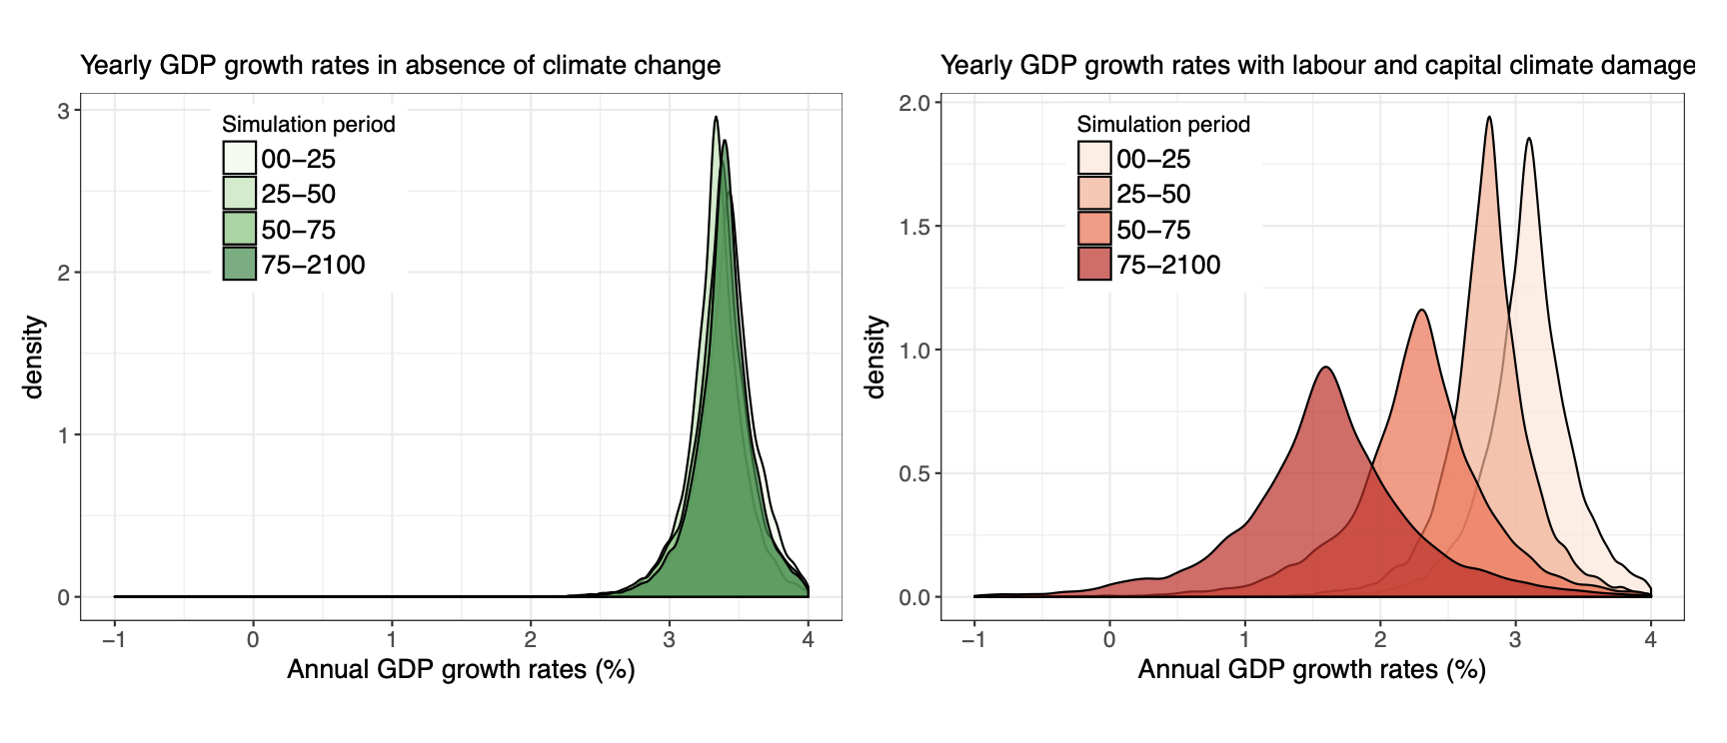
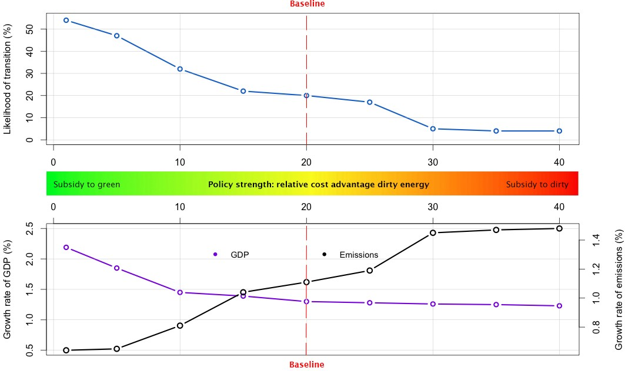
Taking stocks of results
Replicating the styluized facts of the coupled climate and economic dynamics
Shocks are not the same
Importance of a timely transition to achieve temperature targets
No trade-off between sustanibility and growth
Command and control policies are more effective than market-based policies

Slide 6
Shortcomings and future research avenues
More effort towards incorporating inequality issues in integrated assessment analysis
Analysis of the social acceptance of green technologies and of environmental policies
More efforts towards incorporating inter-temporal and welfare considerations from an evolutionary perspective
Incorporating a logic of appropriateness (in contrast to the traditional logic of consequence used in macro models)

