Slide 1
Net-zero innovation
Notes:
No silver bullet, no magic bullet, no single hero to turn the tide of history. It is mostly investment, patience, and careful planning of a highly complex system. However, as innovation economists we intuitively know that there are some leverage points we can intervene to accelerate the transition and make it more possible for the less able and more vulnerable. The bigger question is to know where these points are, and make sure that we don’t push them in the wrong directions.

Slide 2
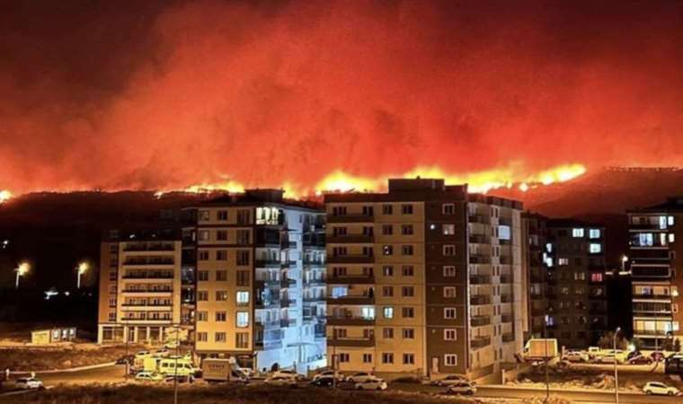
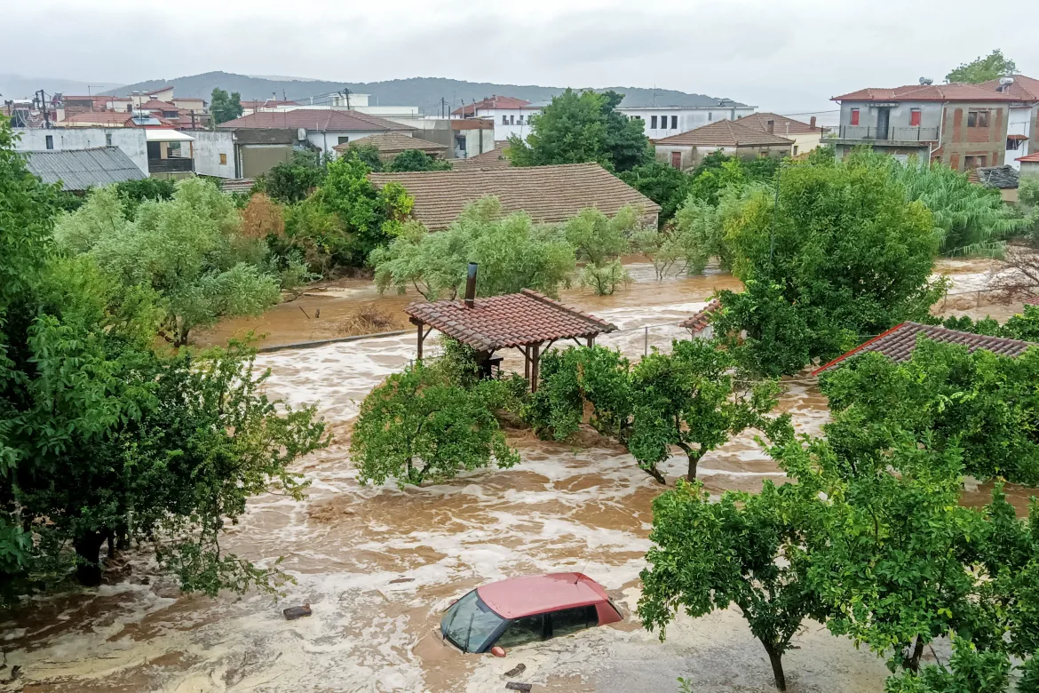
URGENT
Climate change is no longer an abstract concept for us, innovation economists.
Speed is of essence.

Slide 3
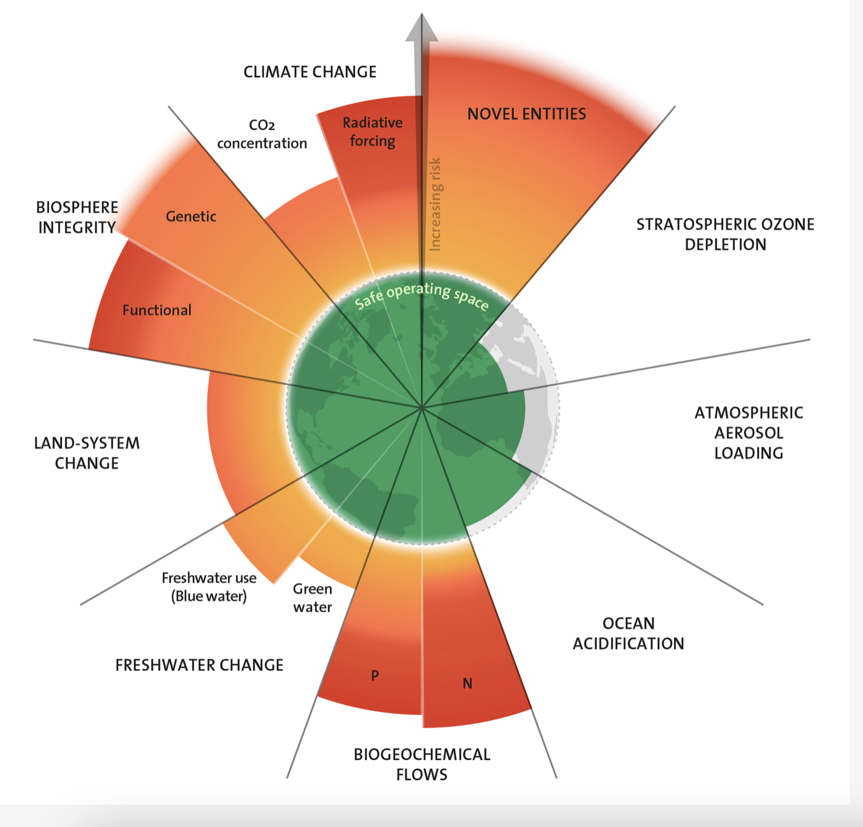
SYSTEMIC AND COMPLEX
Inter-firm, inter-sectoral, international solutions and coordination are central.
Breadth of knowledge and recombinations of knowledge matter.

Slide 4
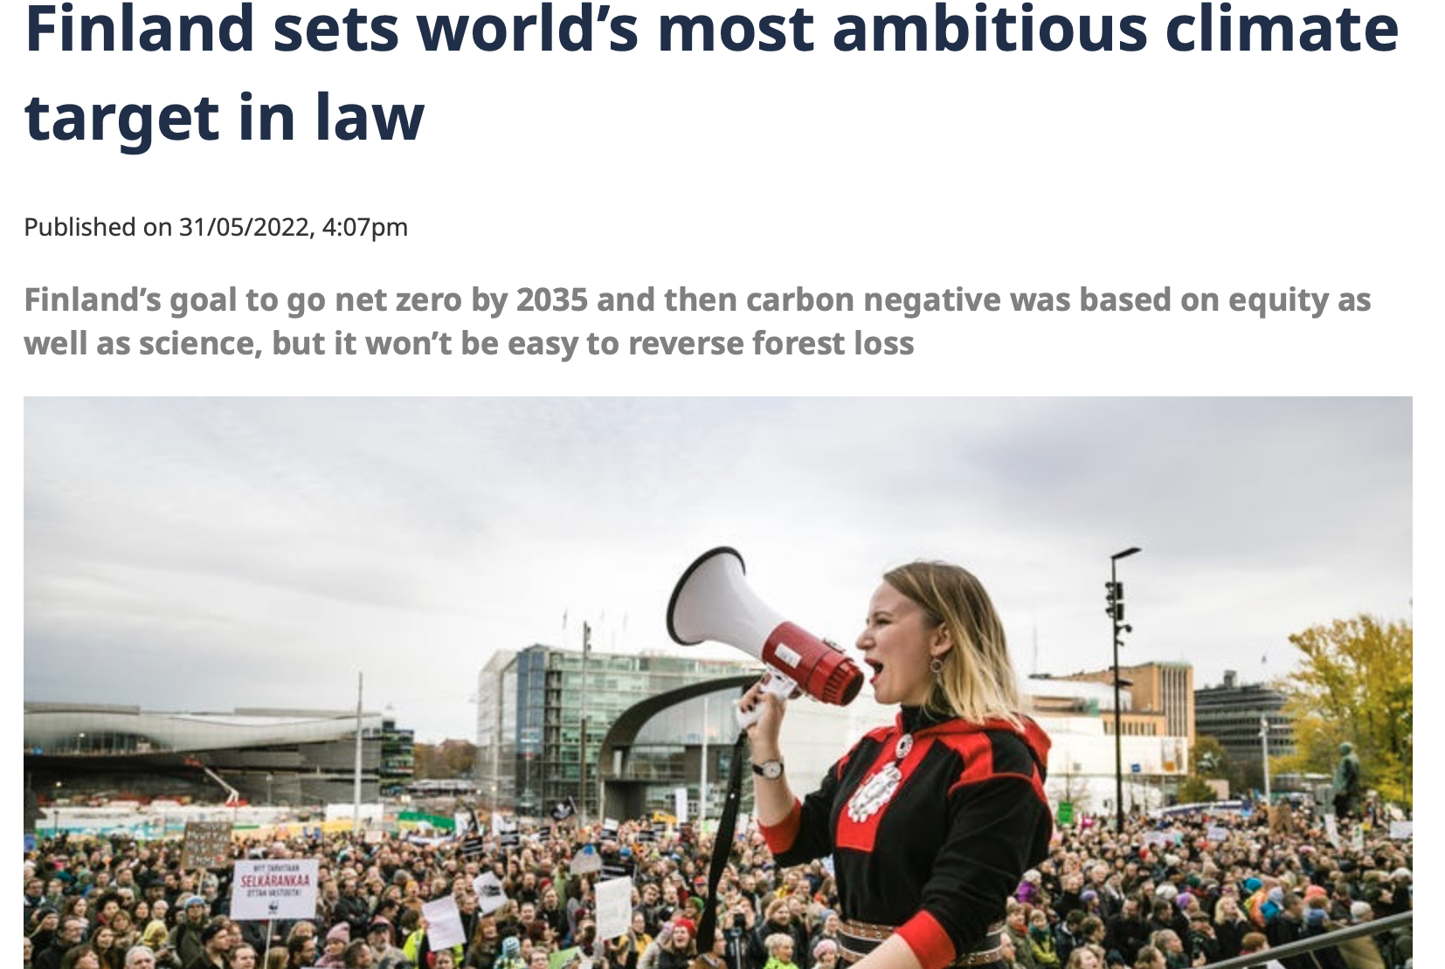
DIRECTIONAL
Government’s role is not trivial.

Slide 5
What do we recommend to firms?
Keep breadth and re-combine (Barbieri et al., 2020; Orsatti et al., 2023)
Collaborate (Ghisetti et al., 2015)
Actively participate in the policymaking, co-create the net-zero transition pathways (Bergek et al., 2023)
SHOULDN’T WE AS A COMMUNITY
TAKE OUR OWN ADVICE ON THESE POINTS TOO?

Slide 6
Where do we need to go further?
Understand sustainability better- so we can capture it better.
Understand the specific challenges to net-zero transition in different sectors and capture these more effectively.
Understand how we can leverage different firm capabilities and different types of innovations for the benefit of green innovations.

Slide 7
Pelin Demirel Dyson School of Design Engineering, Imperial College London.
Email: p.demirel@imperial.ac.uk
pdemirel

