Slide 1
Economics of Innovation Conference
Round Table on «Innovation and Industrial Dynamics»
Milano, 13 September 2023
Chaired by: Elena Cefis _ University of Bergamo
Rui Baptista _ University of Lisbon
Alex Coad _ Waseda University, Tokyo
Orietta Marsili _ University of Bristol
Enrico Santarelli _ University of Bologna

Slide 2
Question 1
What do we know now that we didn't know 20 years ago?
What are the general properties, the stylized facts that we now know and did not know before?
How did we get there? What methodologies have emerged?
Which are the main gaps/shortcomings within our research community, with specific reference to Innovation and Industrial Dynamics (self-criticism) ?

Slide 3
Enrico Santarelli

Slide 4
Round Table on «Innovation and Industrial Dynamics»
What do we know now that we didn't know 20 years ago?

Slide 5
What do we know now…
By overlooking industrial dynamics and assuming that (process) innovation stems from patent races among competing firms, the new IO paradigm created room for the simultaneous emergence of the Economics of Innovation and the Economics of Entrepreneurship as academic fields;
However, these two fields were initially conceptually distant, though not mutually hostile;
Their convergence over the past twenty years has enhanced the toolbox for studying innovation and industrial dynamics;

Slide 6
What do we know now…conceptually
The Entrepreneurial Ecosystems approach was one of the main unifying novelties:
within a territorial unit, a combination of human, organizational and institutional aspects occur, that may facilitate and support the creation and growth of new business activities (Acs, Estrin et al., 2018);
Borrowing from the National Systems of Innovation (Lundvall, 1992) approach, it fused the Economics of Innovation and the Economics of Entrepreneurship in a neo-Schumpeterian framework, enriched by institutional factors.

Slide 7
What do we know now…methodologically
In the context of quantitative research on innovation, we have initiated the utilization of text mining techniques to extract essential information from patent files. This allows us to pinpoint instances where patents with different CPC (Cooperative Patent Classification) codes are converging or intersecting in the technological space:
Facilitating our understanding of the real contribution of innovative entrepreneurship to major technological breakthroughs.
***
In summary, the last two decades of research on innovation and industry dynamics can be encapsulated in one keyword: convergence.

Slide 8
Orietta Marsili

Slide 9
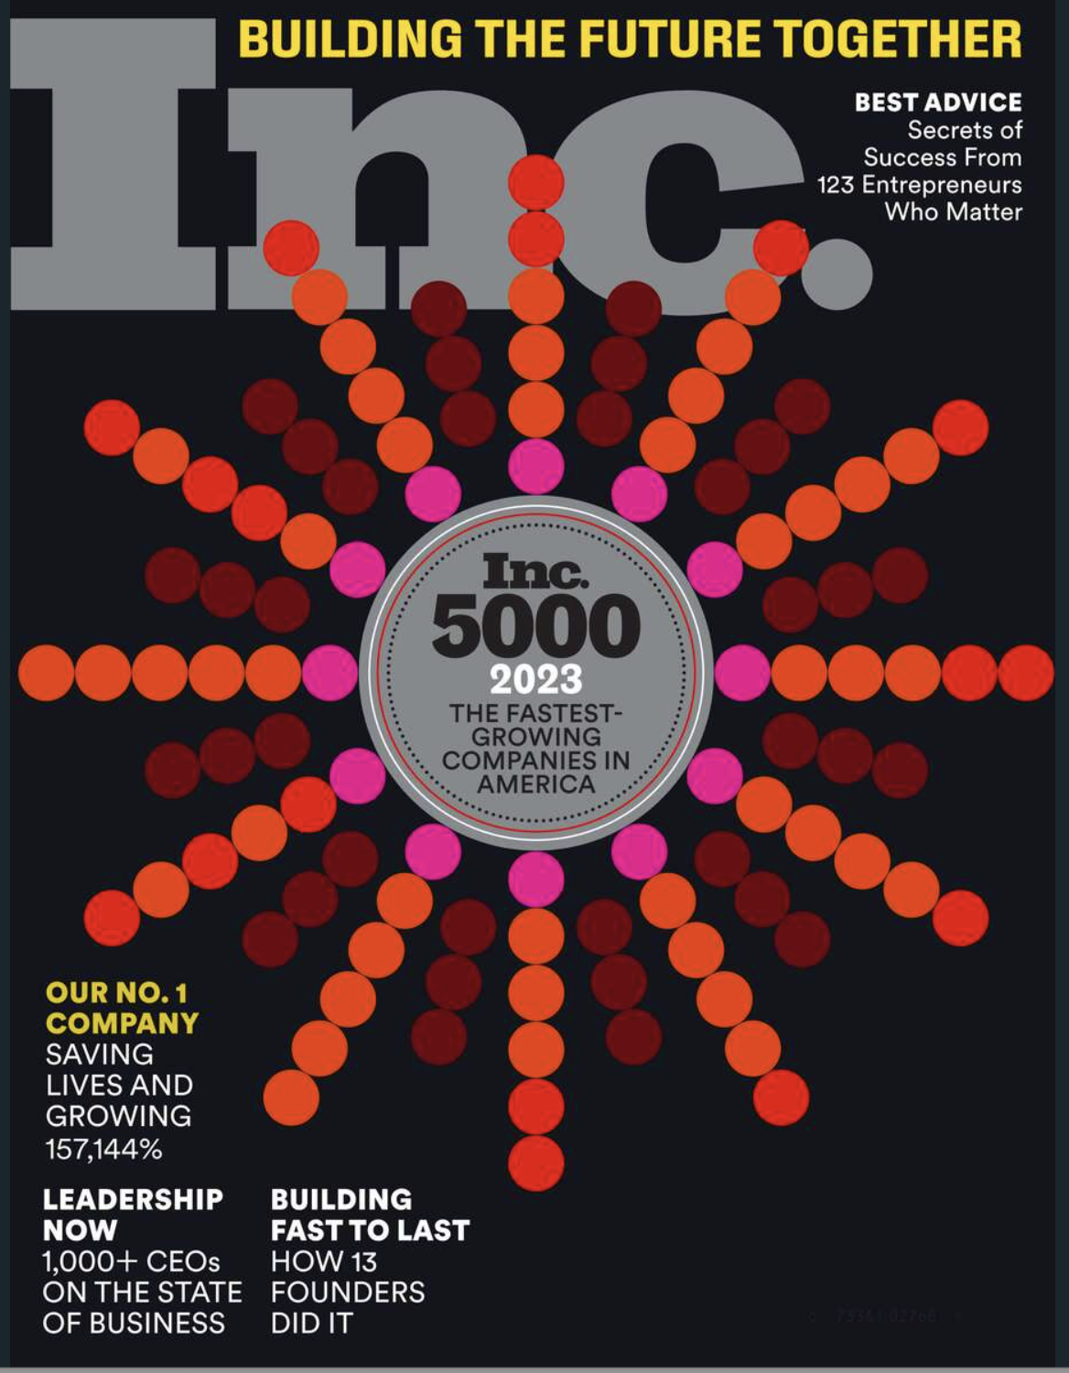

Slide 10
Selection
Liability of newness
Learning
Red Queen effects and external shocks
Liability of smallness
Innovation premium
Risk and uncertainty (R&D)
Exit modes, sequences and timing of change
Strategic fit

Slide 11
Alex Coad

Slide 12
1. What do we know now that we didn't know 20 years ago?
What are the general properties, the stylized facts that we now know and did not know before?
Entry (binary) →Entry modes
Exit (binary) →Exit modes
Growth rate distributions
Co-evolution (SVARs)
High-Growth Firms (HGFs)
Scale-ups (e.g. digital unicorns)

Slide 13
INNOVATION & INDUSTRIAL DYNAMICS: Which are the main gaps/shortcomings within our research community (self-criticism)
Nothing in particular
Let’s keep trying to produce excellent research!

Slide 14
Rui Baptista

Slide 15
What do we know now about Innovation and Industrial Dynamics that we didn't know 20 years ago?
The emergence and diffusion of digital technologies has led to changes in the nature of network effects: while in some markets (e.g., social networks) it has reinforced monopoly power, in other areas the switch from hardware to digital platforms created instability as users and service providers often resort to multiple platforms simultaneously (e.g., Uber/Lyft; Facebook/LinkedIn) – high number of users no longer ensures market power (platforms are more specialised so network effects are more localised)
The extraction and use of big data from digital platforms has created a new kind of competitive advantage that warrants further research – access to big data stimulates innovation but also raises issues of concentration of power by supranational firms that exploit differences in tax and privacy legislation regimes (Nuccio & Guerzoni, 2018)

Slide 16
Question 2
What is the relationship between our research community and mainstream economics, with specific reference to Innovations and Industrial Dynamics (fruitful, neutral, disruptive?)
What is the relationship between our research community and evolutionary economics, with specific reference to Innovation and Industrial Dynamics?

Slide 17
Rui Baptista

Slide 18
What Is the relationship between Innovation & Industrial Dynamics, Mainstream Economics, and Evolutionary Economics?
Technological change continues to be a main determinant of entry and exit, industry structure, and firm strategy and public policy (Klepper, 1996; Agarwal & Gort, 2002)
The emergence of AI is already affecting multiple industries – e.g., healthcare, consultancy (Cowgill, 2019; Galasso & Luo, 2018)
Research has linked the emergence of ICT platforms to declining business dynamism and productivity, and increased concentration (Bijnens & Konings, 2018; Haltiwanger, Hathaway & Miranda, 2014)
Other work suggests that increased exposure to digital platforms facilitates new entry and exit by old incumbents (Bennet & Hall, 2020)
Babina, Fedyk, He & Hodson (2021) find that increased adoption of AI is associated with increases in industry concentration
Acemoglu & Retrepo (2019) find that investments in AI have been primarily labour-saving rather than labour-enhancing

Slide 19
Alex Coad

Slide 20
INNOVATION & INDUSTRIAL DYNAMICS: What is the relationship between our research community and mainstream economics?
FRUITFUL
UNHELPFUL
Interest in firm heterogeneity and selection dynamics
The “empirical turn”
Rigorous analysis of large-sample representative data
Sharing of data
Avoiding disciplinary silos: new insights on phenomena of interest
Mainstream economics sometimes falls back on bizarre assumptions
E.g. the Lucas 1978 model: managers are perfectly matched to firm size according to ability
Reinventing the wheel
E.g. Acemoglu et al rediscovering technological unemployment without building on Vivarelli et al
E.g. suddenly recognizing that firms are not homogeneous
Unhealthy obsession with causality
Referees prefer a paper with bad IV analysis than a good paper without?

Slide 21
INNOVATION & INDUSTRIAL DYNAMICS: What is the relationship between our research community and evolutionary economics?
BUT: Our community = EE?
The conference programme contains many leading EE names

Slide 22
Orietta Marsili

Slide 25
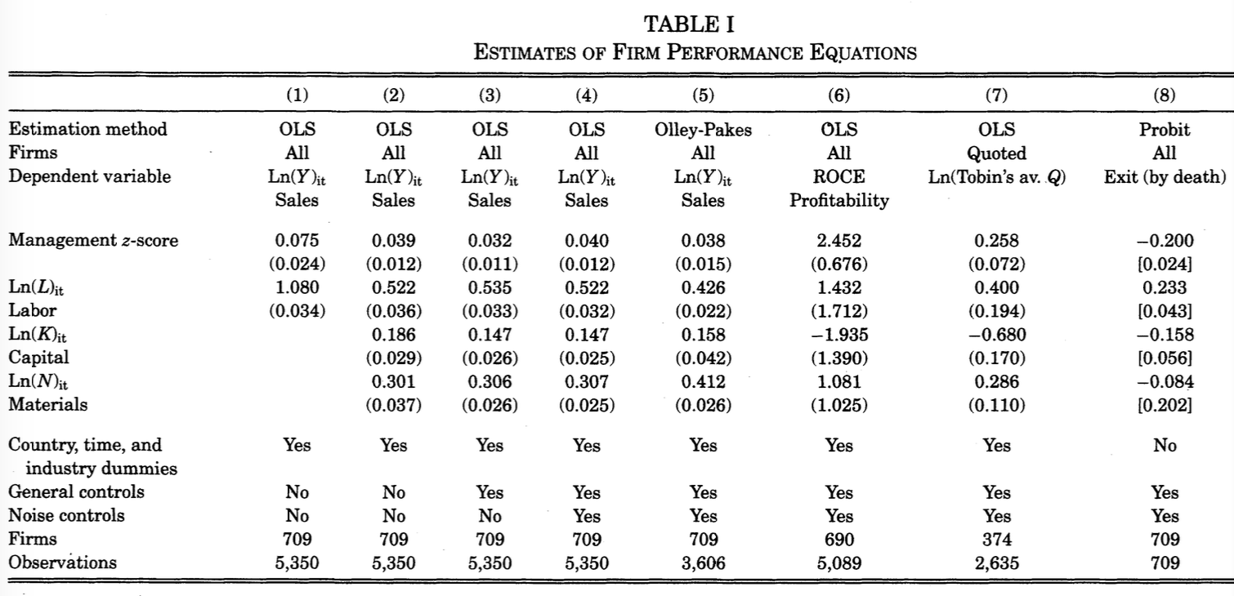

Slide 26
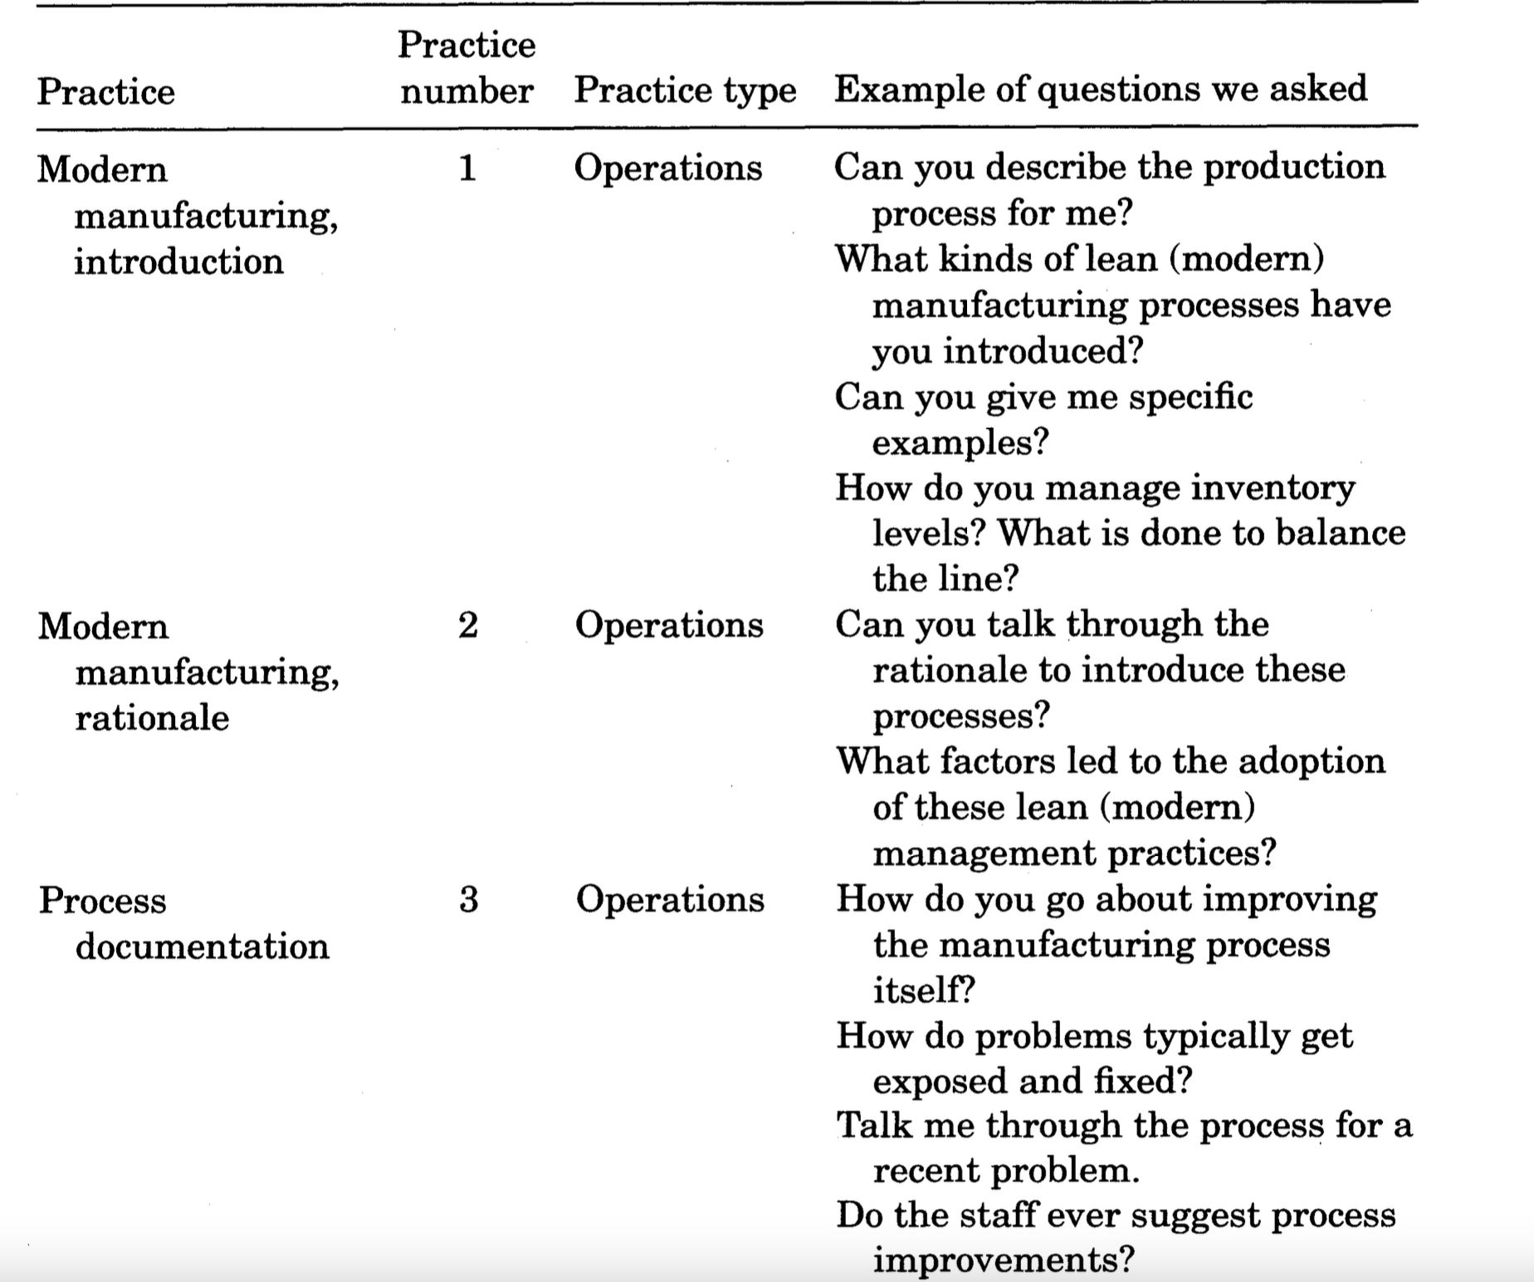

Slide 27
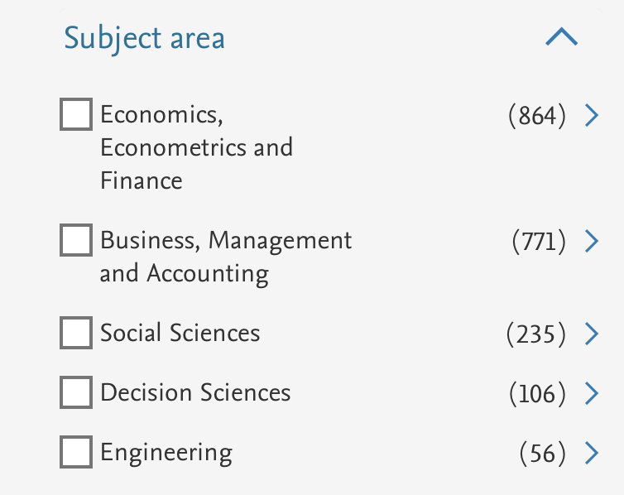

Slide 28
Enrico Santarelli

Slide 29
Round Table on «Innovation and Industrial Dynamics»
What is the relationship between our research community and mainstream economics?

Slide 30
What is the relationship…conceptually
It cannot be denied that over time there has also been another, partly unexpected, convergence: that between our research community and the mainstream;
The Knowledge Spillover Theory of Entrepreneurship (KSTE) (Acs et al., 2009) accentuates the significance of entrepreneurs in the conversion of knowledge with potential economic value into knowledge possessing actual economic value. It therefore offers a 'neo-Schumpeterian' contribution to Endogenous Growth Theory, filling the gaps in its ability to account for the existence of knowledge spillovers;
The Skill-Biased Technological Change (SBTC) theory (Author et al., 1998) integrates the 'factor-biased' approach of mainstream labor economics with the concept from evolutionary economics, suggesting that skill-bias is a long-term historical trend that has gained new momentum from the diffusion of ICT-based technologies;

Slide 31
What is the relationship…methodologically
Since the 1980s, a prevailing view of government's role in the economy has shifted to prioritize “what works” over “what is right”:
thereby resulting in the elimination of the political components of public intervention, as well as the ethical principles and value judgments upon which it is based;
This shared vision has also driven methodological convergence, with both communities increasingly using the Difference-in-Differences approach to assess the (short-term) impacts of new 'treatments' and determine their effectiveness.

Slide 32
Question 3
Which are the most promising avenues for future research on Innovation and Industrial Dynamics?
What are the challenges that we will face due to the introduction of the new digital technologies that are substantially change the process of innovation and the innovation itself?
Are the concepts of industries and sectors still meaningful? Are they still useful instruments for the analysis? Is Industrial Dynamics still possible?

Slide 33
Enrico Santarelli

Slide 34
Round Table on «Innovation and Industrial Dynamics»
Which are the most promising avenues for future research?

Slide 35
Which are the most promising avenues…
Policymakers are reluctant to accept the initial randomness and subsequent path dependency of innovation, as well as the differences between countries and regions in terms of their entrepreneurship capital endowments.
For example, they:
Express concern regarding issues related to the use of AI chatbots;
Speculate about incentivizing the adoption of labor-friendly technologies;
Adopt a 'Hundred Flower Campaign' approach to subsidize all types of new entrepreneurial ventures;

Slide 36
Which are the most promising avenues…
Policymakers and the general public need to be made aware that technological change can occasionally pose a short-term threat but, frequently, offers opportunities for long-term societal progress:
Historical evidence and comparisons with the past can confirm the importance of innovation for societal prosperity;
We must avoid solely fixating on individual elements of the presumed new techno-economic paradigm, like AI chatbots and robots, and instead investigate the feasibility and institutional implications of the broader phenomenon Ginni Rometty, former IBM CEO, called “almost extreme automation”;

Slide 37
Which are the most promising avenues…
Neo-Schumpeterian scholars have a responsibility to dispel fears about technological change and guide policy action in the ‘right’ direction;
On the research side:
Focusing on the potential for recent automation advancements to achieve carbon-free modernization of production systems and to aid in experimenting with innovative societal organizational models.
On the policy actions side:
Recommending the implementation of a universal basic income, funded by tapping into capital income instead of labor income, as a measure to mitigate the unfavorable short-term impacts of automation on the labor force.

Slide 38
Orietta Marsili

Slide 39
Selection
Liability of newness
Learning
Red Queen competition and external shocks
Liability of smallness
Innovation premium
Risk and uncertainty (R&D)
Exit modes , sequences and timing of change
Residual value
Resource transfer
Strategic fit
Transmission

Slide 40
Alex Coad

Slide 41
INNOVATION & INDUSTRIAL DYNAMICS: Which are the most promising avenues for future research?
Big data techniques for prediction (LASSO, CART, Neural Networks, Deep Learning; also Google Trends)
Text as data
SVARs for describing co-evolutionary dynamics
Finer-grained data
Product-level data
Tracking machines via serial numbers
Ma, Murfin, Pratt, (2022, Young Firms, Old Capital; JFE)

Slide 42
Rui Baptista

Slide 43
Which are the most promising avenues for future research? Challenges raised by new digital technologies
Technology spillovers are geographically localised (Audretsch & Feldman, 1996); Baptista & Swann, 1998; Boschma, 2005)
Entrepreneurial Ecosystems (EE) (Stam & Spiegel, 2016) provide a potentially useful framework to study the relationship between technology and industrial dynamics
Entrepreneurial ecosystems are networks of actors, institutions, resources and culture that support and enable entrepreneurship and industry dynamics in an industry or region
A region's exposure to AI generates tacit knowledge about how to work with and benefit from the technology that in turn constitutes a capability upon which future innovation will build; one might expect that the effect is greater in areas where there are more interactions and entry/exit dynamics (Felten, Raj & Seamans, 2021)

Slide 44
Entrepreneurial Ecosystems (EE) and Industry Dynamics
Entrepreneurial ecosystems can foster industrial dynamics by creating new firms, products, markets and technologies that challenge the existing ones and stimulate innovation and competition
Entrepreneurial ecosystems can also adapt to industrial dynamics by shifting their focus from new firm creation to internal commercialization of knowledge, or vice versa, depending on the stage and needs of the industry
Entrepreneurial ecosystems can influence and be influenced by the industrial policies, regulations, standards and infrastructure that affect the opportunities and barriers for entrepreneurship in different industries

Slide 45
EE Evolution and Digital EE
Studying the evolution dynamics of EE through their birth, growth, maturity, decline, and revival can provide novel insights into industry and regional evolution
Cantner, Cunningham, Lehman & Menter (2021) take an industry life cycle perspective, proposing that EE transition from entrepreneurial ecosystems, focused on creating new companies, to business ecosystems, where the central focus is on intrapreneurial activities
Other literature focuses specifically on Digital EE, which exploit digital resources for the detection and pursuit of entrepreneurial opportunities through business model innovation (Autio, Nambisan, Thomas & Wright, 2018)
Digital EE are characterized by voluntary horizontal spillovers of knowledge into a “collective intelligence” (Elia, Margherita & Passiante, 2020)

